Slide 1
SYRIA TEL COMMUNICATION CHURN PREDICTION
BY KEVIN KISENGU

Slide 2
GOAL
Project Goal: Predict customer churn to enable proactive retention strategies
Tools: Python, Pandas, Scikit-learn, SMOTE, Matplotlib
Target Audience: Telecom business managers

Slide 3
PROJECT OVERVIEW
we want to identify “at-risk” customers before they leave since every customer who leaves costs syriatel money.
This can be achieved by pondering the question, “Are there any predictable patterns in customer behaviour?”

Slide 4
DATA ANALYSIS/APPROACH
.Data cleaning and preprocessing of customer data
.Handling class imbalance using SMOTE
We Built two different prediction models using the syriatel churn dataset
(LOGISTIC REGRESSION and DECISION TREE)
Trained on 80% of customers and tested on the remaining 20%.
KEYWORDS
roc-auc - a measure of how well the model seperates leavers from stayers.
recall - of all customers who actually left,how many did we catch?
precision - of customers flagged as “high risk” , how many actually left?

Slide 5
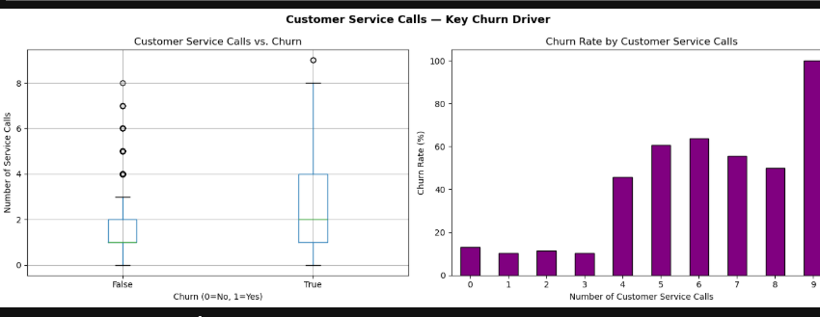
EDA 1 BY CUSTOMER SERVICE PLANS

Slide 6
EDA 1 BY CUSTOMER SERVICE PLANS: cont
Interpretation: Customers with an international plan churn at nearly 3x the rate of those without.
Customers without a voicemail plan churn more than twice as often, suggesting voicemail may increase engagement and loyalty.

Slide 7
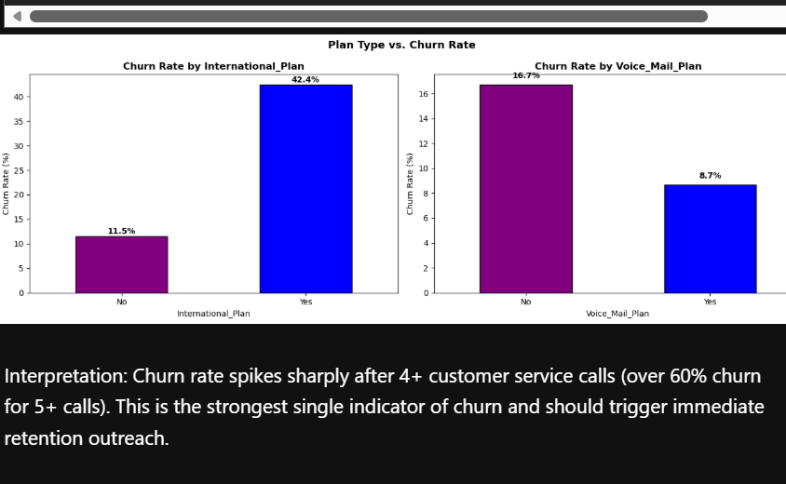
EDA 2. CHURN RATE BY INTERNATIONAL PLAN

Slide 8
BUSINESS FINDINGS
we found factors that increase churn risk:
1. high number of customer service calls (greater than 3) = risk
2. high daytime charges meant customers felt overcharged
3. having an international plan
we also found factors that reduce churn risk
1. having a voicemail plan
2.higher evening usage

Slide 9
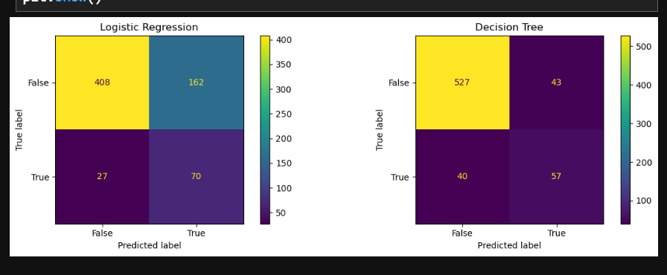
BUSINESS FINDINGS:cont
Both models work well, but logistic regression is more reliable for daily predictions since it correctly identifies 8/10 customers who will churn and gives accurate risk scores making it more robust for daily use in comparison to its decision tree counter-part.

Slide 10
BUSINESS RECOMMENDATIONS
ACTION | TARGET
call retention team | customers with more than 3 service calls in a month
weekly risk report | all active customers scored by the logistic regression model(immediate outreach)

Slide 11
NEXT STEPS
A simple dashboard should be created to update churn risk on a weekly basis(excel would suffice)

